Slide 1

SQL (Structured Query Language)
Sarower Ahmmed

Slide 2
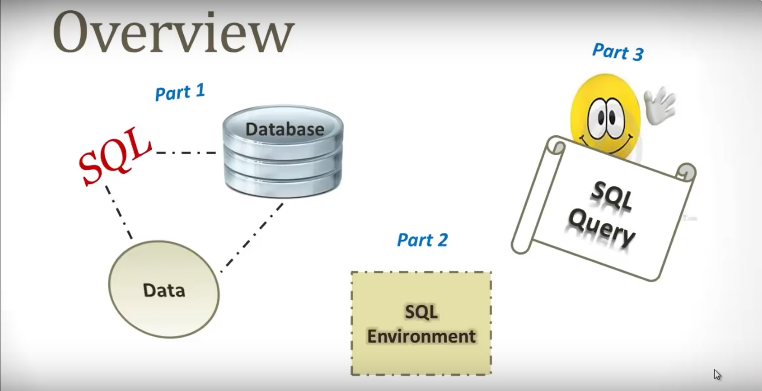
RDBMS,
Table &
Keys

Slide 3

DATA
Any meaningful information is data.
Has to be recordable.
Information came in row or unorganized form.

Slide 4


Slide 5



Slide 7
Open browser> request send> web server> Application server & data base server
Response > Application and Database server> web server> Browser

Slide 8
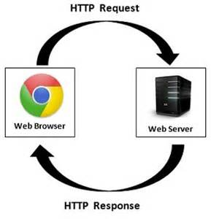

Slide 9
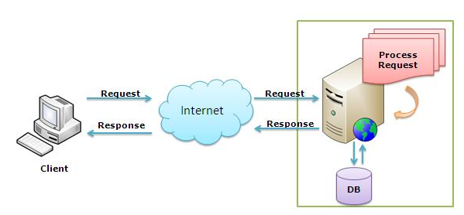

Slide 10
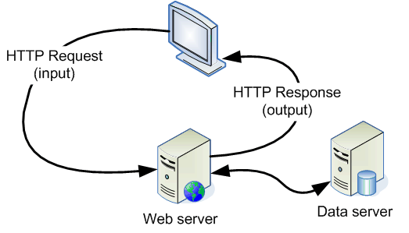

Slide 11
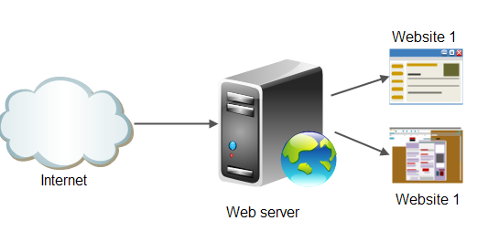

Slide 12
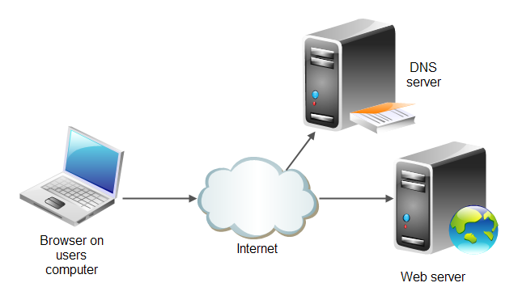
A DNS server or Domain Name Server is part of a huge database spread out across the Internet. Any time you visit a site by typing in a name, like www.google.com or www.yahoo.com, the DNS server converts that name into an IP address

Slide 13
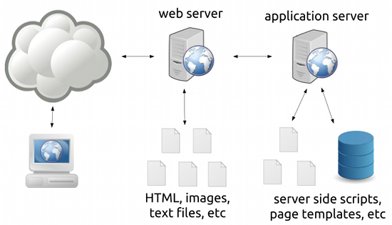

Slide 14
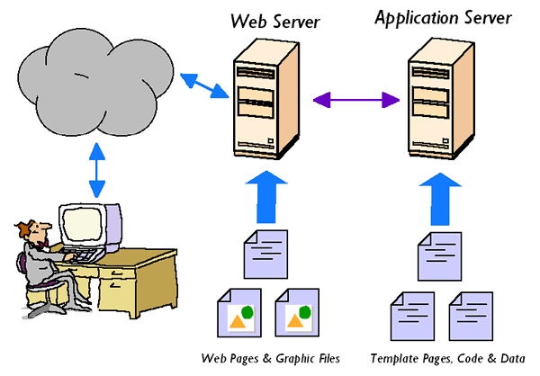

Slide 15
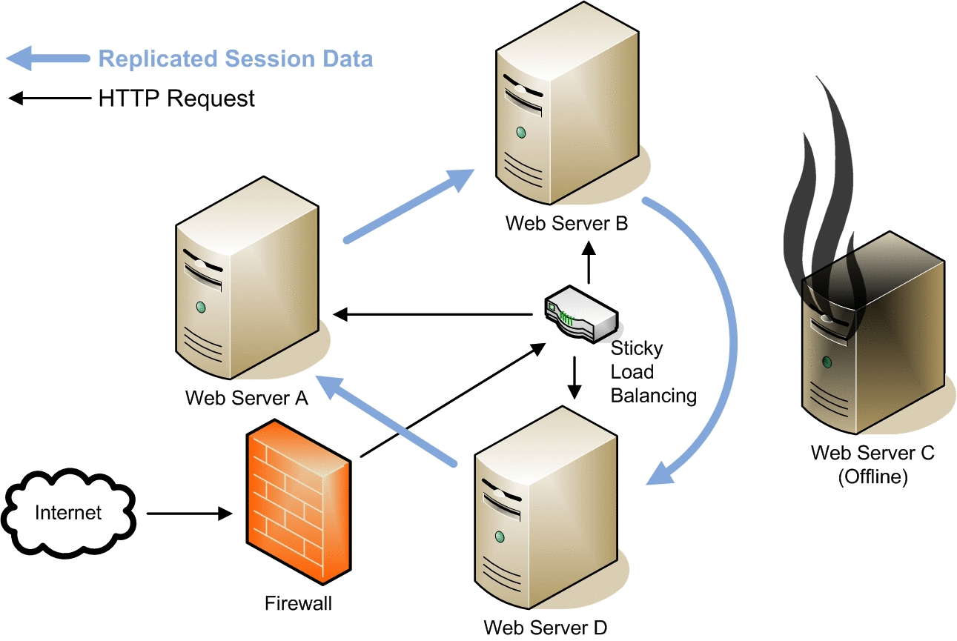

Slide 16


Slide 17



Slide 18


Slide 19
Web application Tier/layer
Tier | Contain | Language | Example | Testing
Front end /browser/GUI | Browser | HTML, JavaScript, CSS | IE, chrome | Manual + Automation
Middle end | Web server | XML, Jason | Apache web server – the HTTP web server | Web services testing(SOAPUI)
Back end | Database server | Database= SQL | SQL server, Oracle, MySQL | SQL testing/backend testing+ Automation
Application server + | Application server or client server | App=JAVA, C#,C++,Python,ruby,perl | Apache Tomcat | Manual + Automation

Slide 20

Database/RDBMS
The Oxford English Dictionary :
1962 report by the System Development Corporation of California as the first to use the term "data-base" in a specific technical sense
RDBMS=1969-70 by Dr Edgar Codd

Slide 21
Database
DBMS-(1960)
A database management system (DBMS) is system software for creating and managing databases.
The DBMS provides users and programmers with a systematic way to create, retrieve, update and manage data.
Database schema, which defines the database’s logical structure

Slide 22
Two main types of databases:
SQL /RDBMS
NoSQL/NRDBMS
or,
relational databases and
non-relational databases.

Slide 23
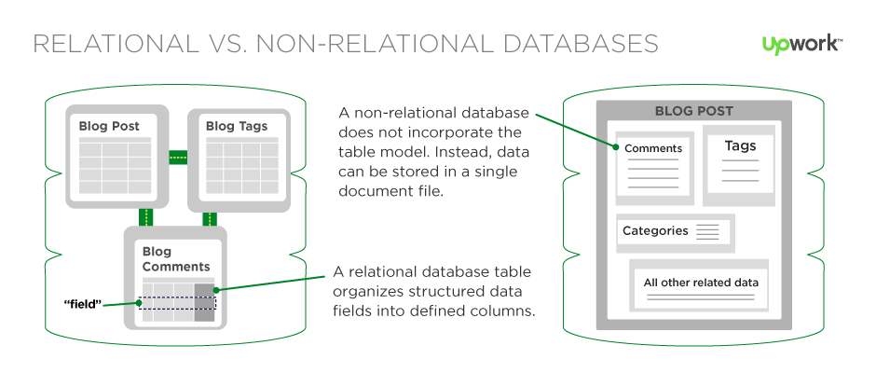

Slide 24
Popular types of DBMS
Relational database management system (RDMS)
NoSQL /NRDBMS or In-memory database management system (IMDBMS) - provides faster response times and better performance.
Columnar database management system (CDBMS) - well-suited for data warehouses that have a large number of similar data items.
Cloud-based data management system - the cloud service provider.

Slide 25

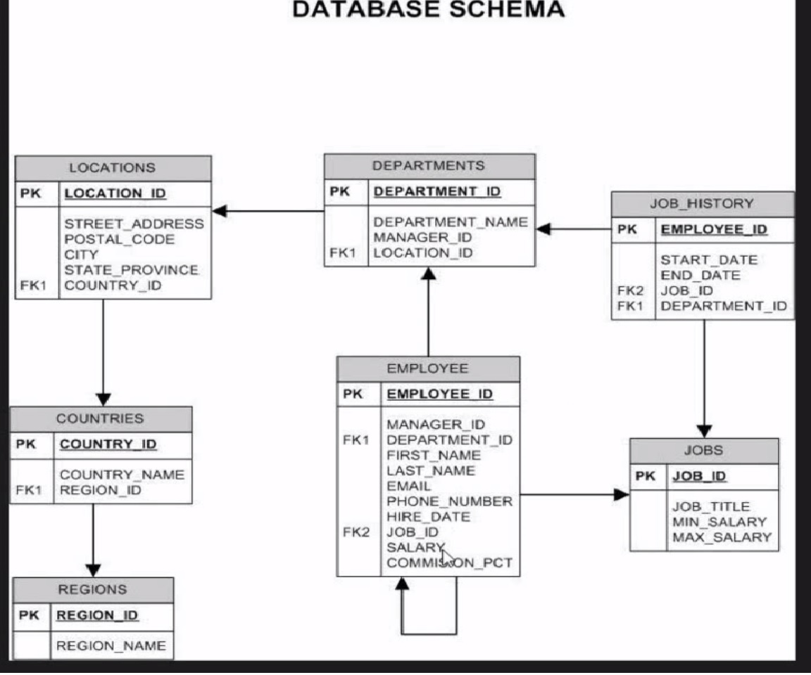
RDBMS Relational database management system

Slide 26
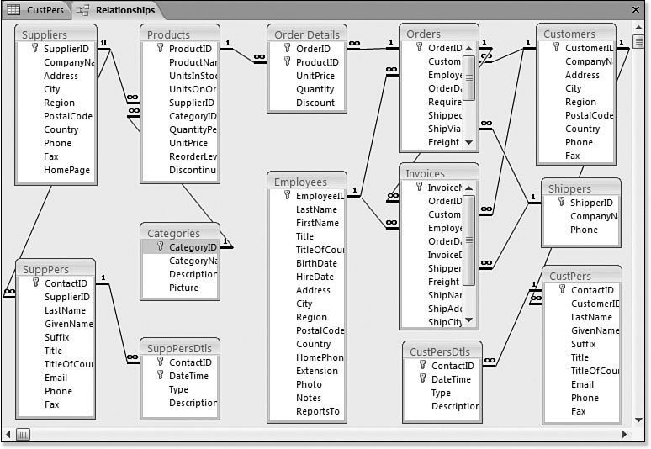

Slide 27
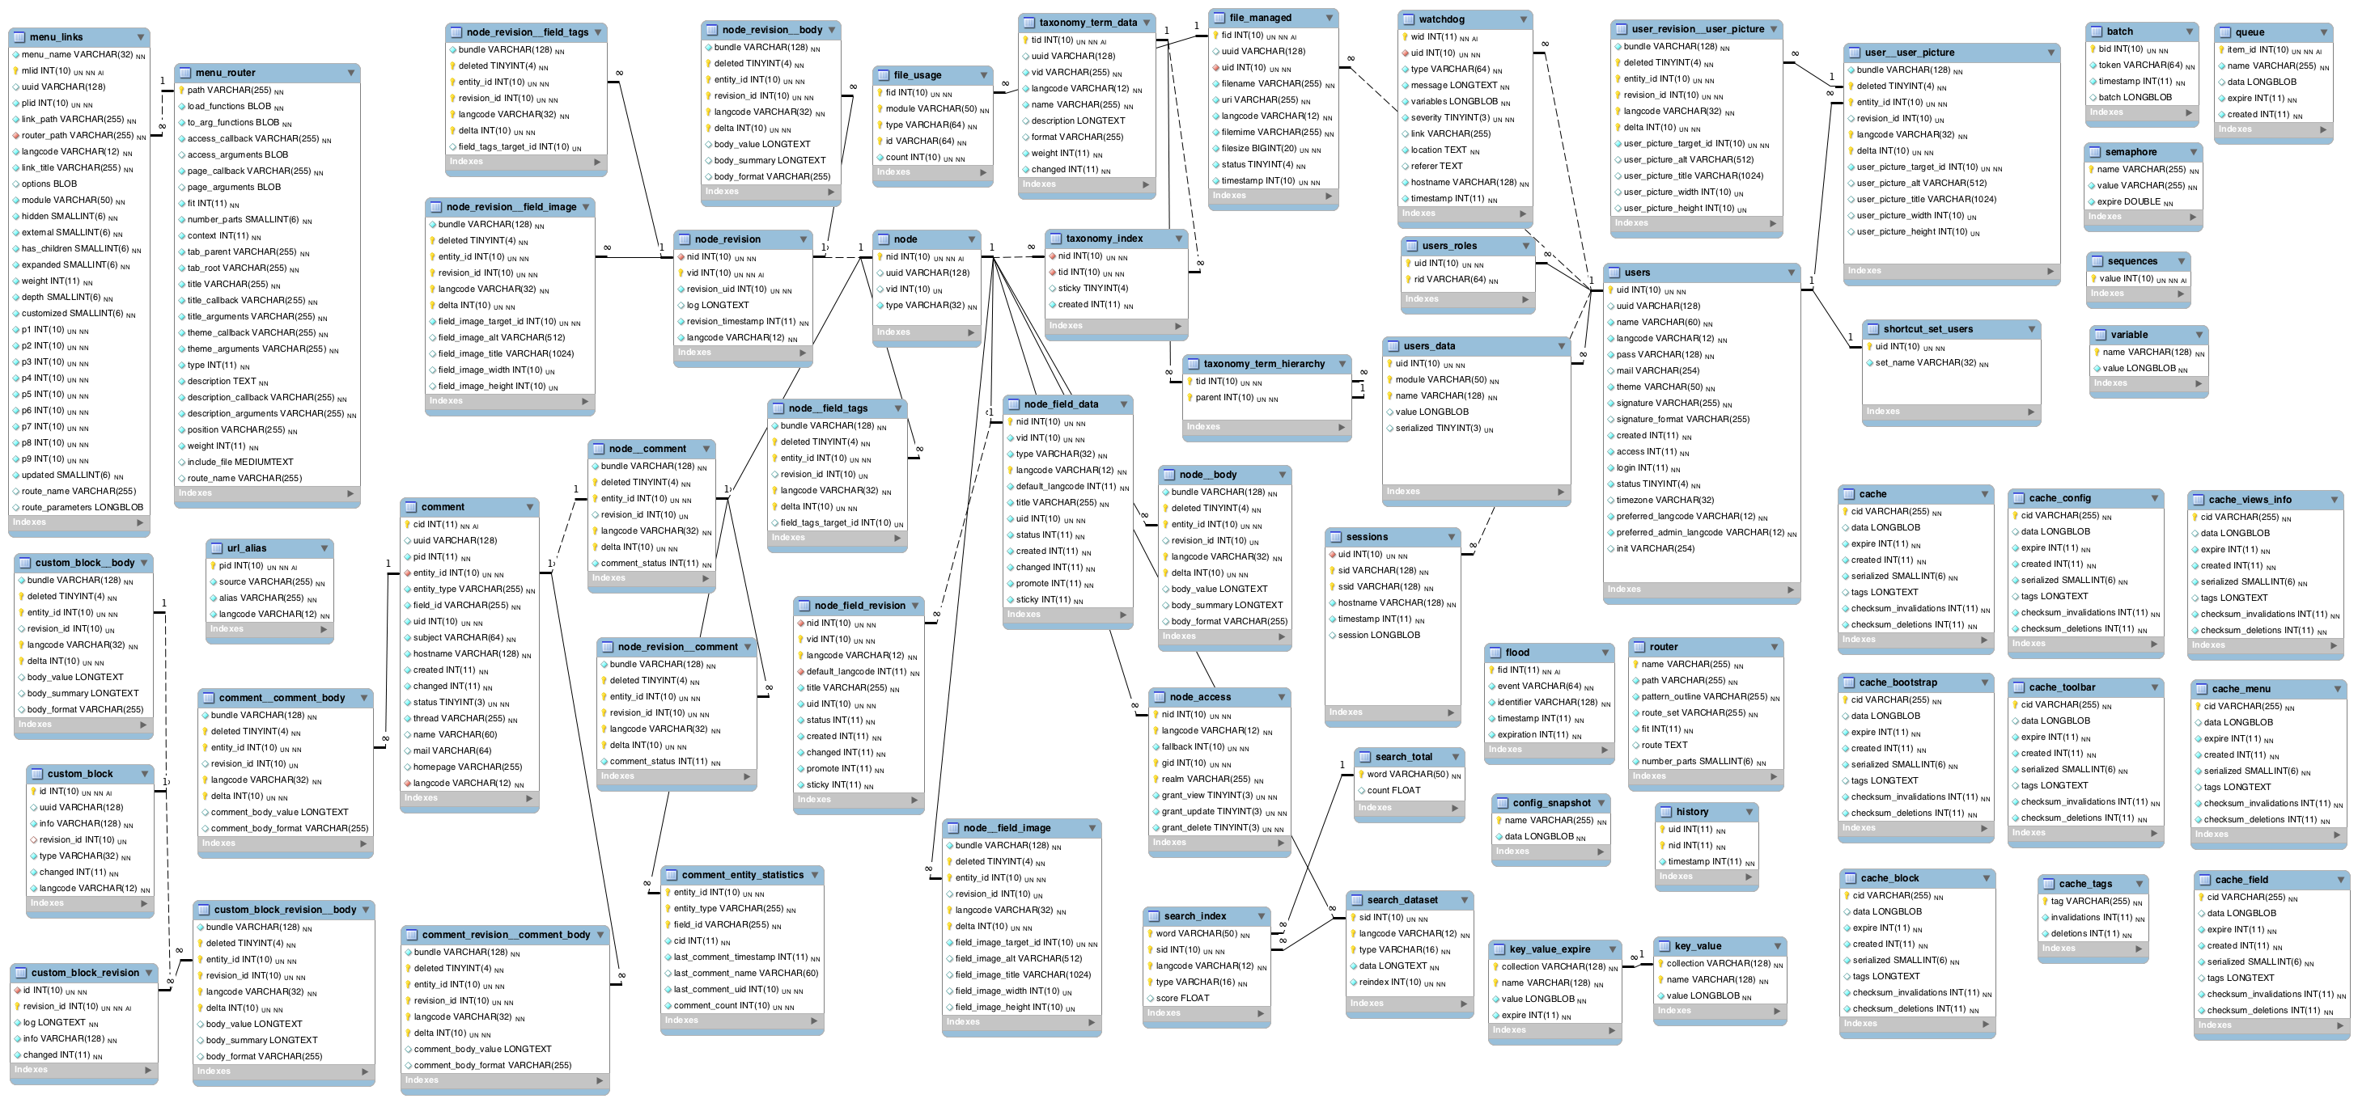

Slide 28
WHY SQL??
Based on Java
Its use for Database/Backend testing
To access database and manipulate data.
Limited number of command & very easy to understand.
SQL is designed for managing data that held in RDBMS.

Slide 29
What Can SQL do?
SQL can execute queries against a database
SQL can retrieve data from a database
SQL can insert records in a database
SQL can update records in a database
SQL can delete records from a database
SQL can create new databases
SQL can create new tables in a database
SQL can create stored procedures in a database
SQL can create views in a database
SQL can set permissions on tables, procedures, and views

Slide 30
SQL(Structured Query Language)
Start 1970
Old sequel >>Microsoft bought >SQL
Query= search database(data-rt / wrong).
4th generation language =>interact database.
Standard by organization ANSI
Standard SQL: work in any relational data
management system(RDMS).

Slide 31

Types of Database/RDBMS
Oracle- the largest DB.

Slide 32
Table in Database
Consists of columns and rows.
Collection of inter-related DATA.
Table name must be unique.
Must have one PK(primary key)-must not be null/ empty.
It can have one/multiple FK(foreign keys).

Slide 33

Key??
According to the SQL Standard, a key is
a subset of columns in a table that allow a row to be uniquely identified.
Types of Keys:
Primary
Foreign
Unique
Natural
Super
Candidate

Slide 34
Primary key uniquely identifies each row in the table.
This is a special kind of unique key.
Foreign key creates a relationship between the two tables. Therefore values of a foreign key must match existing values of the primary key to which it refers.
Unique key
The UNIQUE constraint uniquely identifies each record in a database table.
The UNIQUE and PRIMARY KEY constraints both provide a guarantee for uniqueness for a column or set of columns.
Candidate Key: A candidate key has all the characteristics to be a primary key.

Slide 35

Primary | Foreign | Unique
No Null value | Null value | Null value
One- in a table | One/multiple | One/multiple
Unique value | Unique vale | Unique value
Not make relation | make relation | Same a primary key
Mainly function-identify a table uniquely | Mainly function-Relation between two table | Mainly function-Same a primary key
Clustered index | Non-clustered index | Non-clustered index

Slide 36


Slide 37

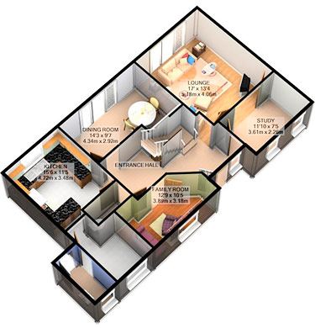


Slide 38
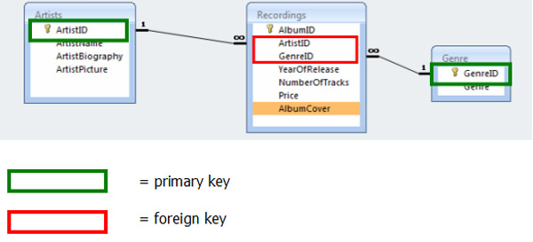




Slide 40
Syntax: (noun)the arrangement of words and phrases to create well-formed sentences in a language.
A clause is a group of related words containing a subject that tells readers what the sentence is about, and a verb that tells readers what the subject is doing.
Operator: a person who operates equipment or a machine

Slide 41
SQL Syntax
SQL is NOT case sensitive:
SELECT select;
FROM from;
SELECT * FROM table_name;
Some database systems require a SEMICOLON at the end of each SQL statement.

Slide 42
Basic SQL Syntax
Select used to select column of any Table
Select All column= SELECT *
Select specific column= SELECT column_name1,column_name 2
DISTINCT =remove all duplicate value
SELECT DISTINCT(column_name1)
Select distinct column_name
From Table_name
from?
FROM table_name

Slide 43
`
WHERE condition [eliminate unwanted row=filters data]
ORDER BY des/asd [arrange the column]-
by default always come with ASD if nothing mention.
but des have to write des.

Slide 44
Interview Question?
How to filter data from database?

Slide 45
Lets get start with Queries

Slide 46
SELECT & FROM clauses
Select all the columns →
SELECT *
FROM table_name
Select specific column
SELECT column_name1,column_name2
FROM table_name
Select distinct values across specific columns
SELECT distinct (manager_id)
FROM table_name

Slide 47
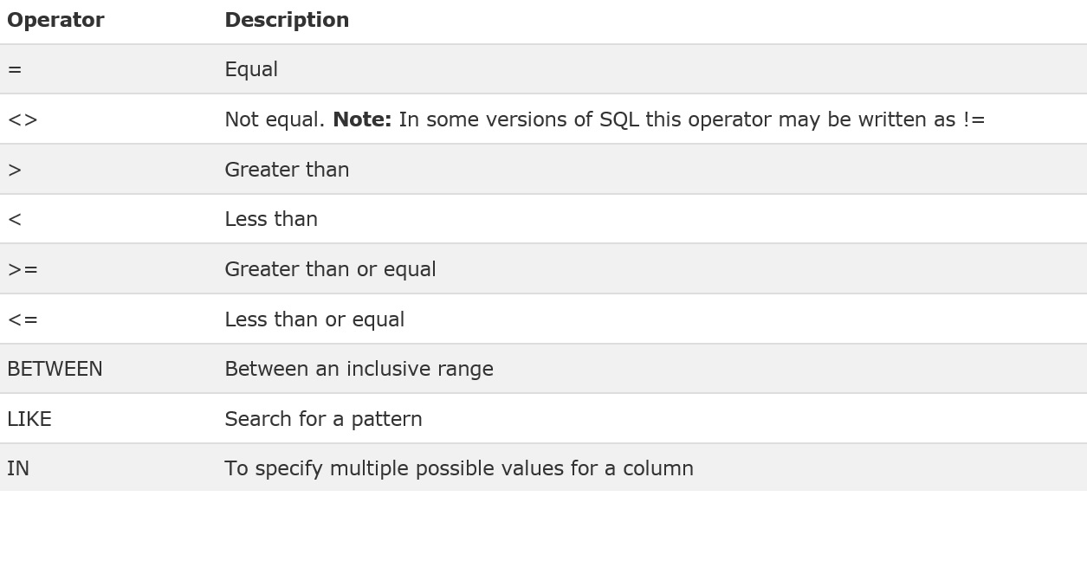
WHERE Clause(conditional operator)
----select subset of data
SELECT column_name,column_name
FROM table_name
WHERE column_name operator_value [AND/OR] column_name operator_value
Comparison operators
LOGICAL OPERATOR
IS NULL
And , or
Conjunctive Operators

Slide 48
Types of Operators
Comparison: Establishes relationship between 2 values.
Logical: Establishes the state of specified condition.
Conjunctive: Allows multiple conditions to be tested.
Arithmetic: Allows mathematical functions to be performed.

Slide 49
SQL > SQL Commands > Wildcard
Wildcards are used in SQL to match a string pattern. There are two types of wildcards:
% (percent sign) represents zero, one, or more characters.
_ (underscore) represents exactly one character.
Wildcards are used with the LIKE operator in SQL.

Slide 50
Below are some wildcard examples:
'A_Z': All string that starts with 'A', another character, and end with 'Z'.
For example, 'ABZ' and 'A2Z' would both satisfy the condition, while 'AKKZ' would not (because there are two characters between A and Z instead of one).
'ABC%': All strings that start with 'ABC'.
For example, 'ABCD' and 'ABCABC' would both satisfy the condition.
'%XYZ': All strings that end with 'XYZ'.
For example, 'WXYZ' and 'ZZXYZ' would both satisfy the condition.
'%AN%': All strings that contain the pattern 'AN' anywhere.
For example, 'LOS ANGELES' and 'SAN FRANCISCO' would both satisfy the condition.
'_AN%': All strings that contain a character, then 'AN', followed by anything else.
For example, 'SAN FRANCISCO' would satisfy the condition, while 'LOS ANGELES' would not satisfy the condition.

Slide 51
SQL > SQL Commands > LikeThe LIKE operator is used to filter the result set based on a string pattern. It is always used in the WHERE clause.
The syntax for the LIKE operator is as follows:
SELECT "column_name" FROM "table_name" WHERE "column_name" LIKE {PATTERN};
{PATTERN} often consists of wildcards. We saw several examples of wildcard matching in the previous section.

Slide 52
SQL > SQL Commands > Alias
Alias refers to the practice of using a different temporary name to a database table or a column in a table.
The main advantage of using an alias is to help make the SQL statement more concise and readable. In addition, the output of the SQL statement can become more understandable with the use of an alias.

Slide 53
Syntax
The syntax for a table alias and a column alias is as follows:
SELECT "table_alias"."column_name1" "column_alias" FROM "table_name" "table_alias";
Both types of aliases are placed directly after the item they alias for, separate by a white space.

Slide 54
SQL > SQL Commands > AS
keyword AS is used to assign an alias to the column or a table. It is inserted between the column name and the column alias or between the table name and the table alias

Slide 55
Syntax
The syntax for using AS is as follows:
SELECT "table_alias"."column_name1" AS "column_alias" FROM "table_name" AS "table_alias";

Slide 56
SELECT first_name,last_name, salary,email,phone_number
FROM employees
WHERE employee_id =10
SELECT first_name,last_name, salary,email,phone_number
FROM employees
WHERE employee_id in(100,102,103);
SELECT first_name,last_name, salary
FROM employees
WHERE salary>7000
order by salary desc
SELECT first_name,last_name, salary, department_id
FROM employees
WHERE salary>8000 AND department _id in (100,110,130)
order by salary desc,last_name

Slide 57
Some impotant terminology>>
ERD(entity relation diagram): A graphical representation of the entities (Tables) and their relationships.
Normalization: Process of decomposing large table to eliminate redundant data.
Process of developing or designing data base
1st create a big data table
Break into simple/normal
1st normal form
2nd normal form
3rd normal form
DDL-(data definition languages)- create /alter table>>data administrator use it, deal with structure of database
DML(data manipulation languages)- As QA, we need this languages.

Slide 58
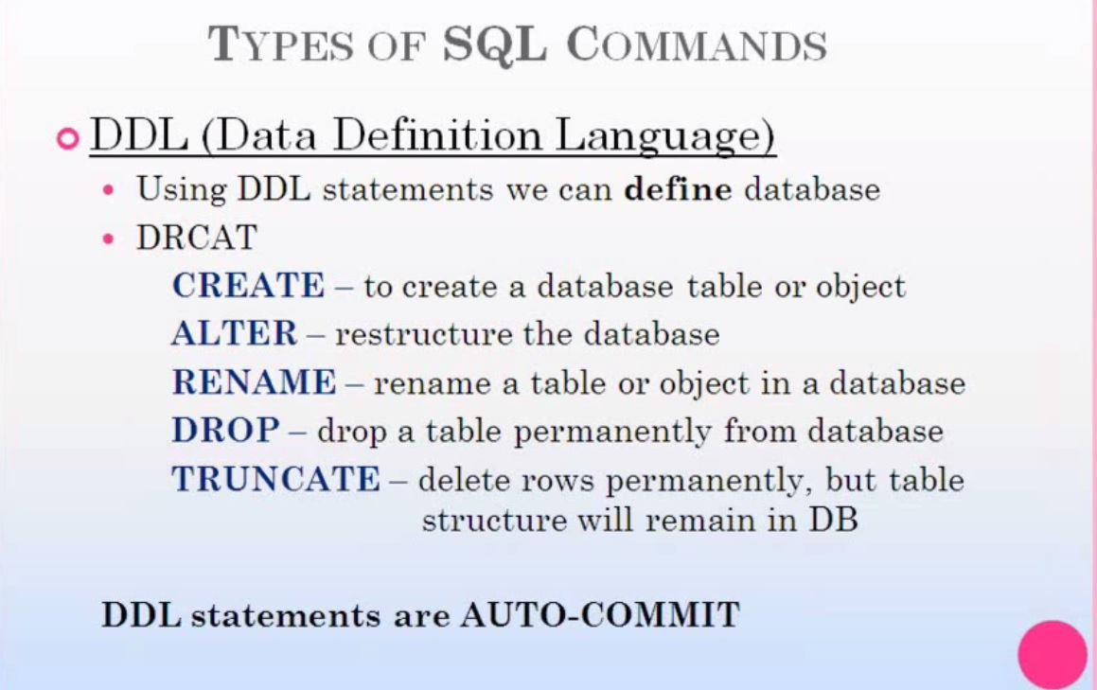
ROLL BACK NOT POSSIBLE

Slide 59
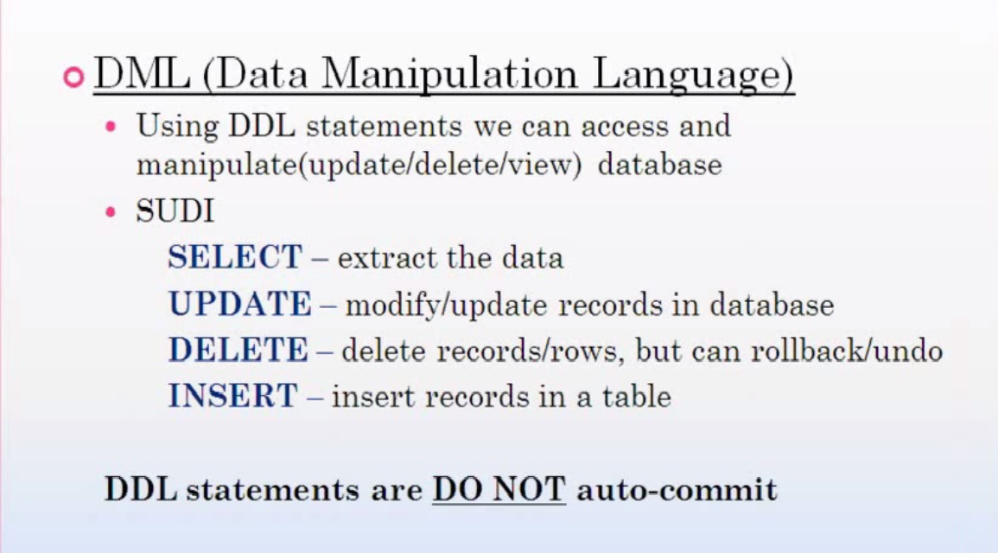
DMLM
ROLL BACK POSSIBLE

Slide 60
Some of The Most Important SQL Commands
SELECT - extracts data from a database
UPDATE - updates data in a database
DELETE - deletes data from a database
INSERT INTO - inserts new data into a database
CREATE DATABASE - creates a new database
ALTER DATABASE - modifies a database
CREATE TABLE - creates a new table
ALTER TABLE - modifies a table
DROP TABLE - deletes a table
CREATE INDEX - creates an index (search key)
DROP INDEX - deletes an index

Slide 61
DELETE | DROP | TRUNCATE
DML | DDL | DDL
Remove row data | Remove Table data | Remove table data with table structure
No table structure remove | No table structure remove | Yes table structure remove
No Auto commit | Yes Auto commit | Yes Auto commit
Yes Rollback | No Rollback | No Rollback
Can remove row data | Can remove table data | Can remove table data

Slide 62
FUNCTION

Slide 63
Single Row Functions/group
Operate on one row at a time, and return one row of output for each input row.
CONCAT(x, y) – Append two string and return the resulting string.
LOWER() & UPPER() – Converts letter to lower or upper character
SUBSTR() – Return substring of a string input
ROUND() – Get the result of rounding value, a whole number.
DISTINCT() – eliminate duplicate records.

Slide 64
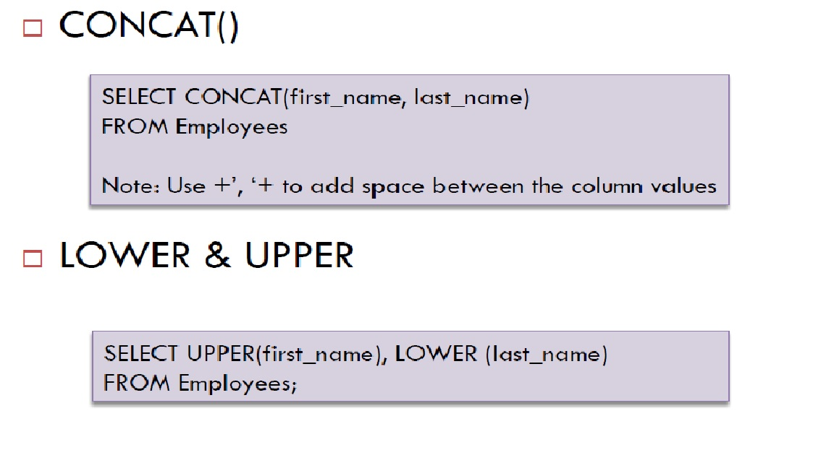
Eamples

Slide 65
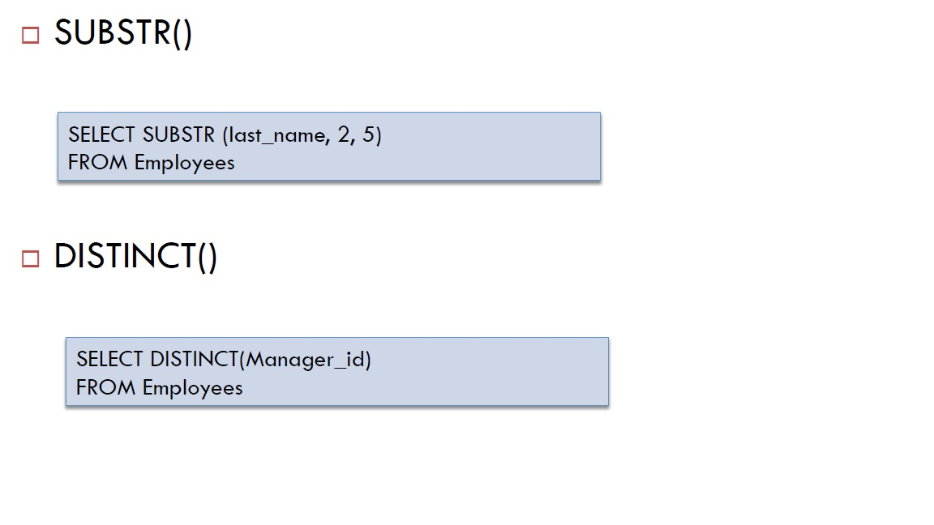
Examples

Slide 66
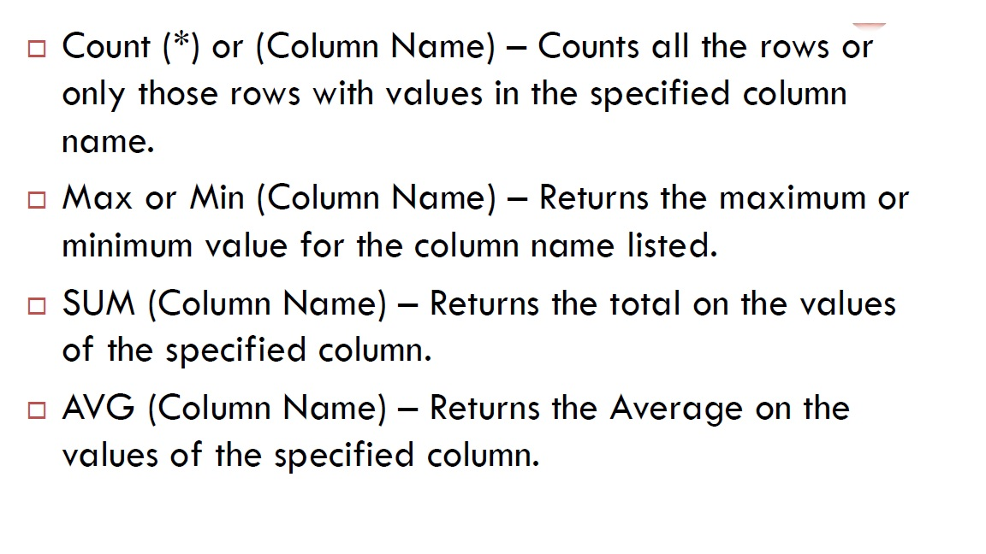
Aggregate Function

Slide 67
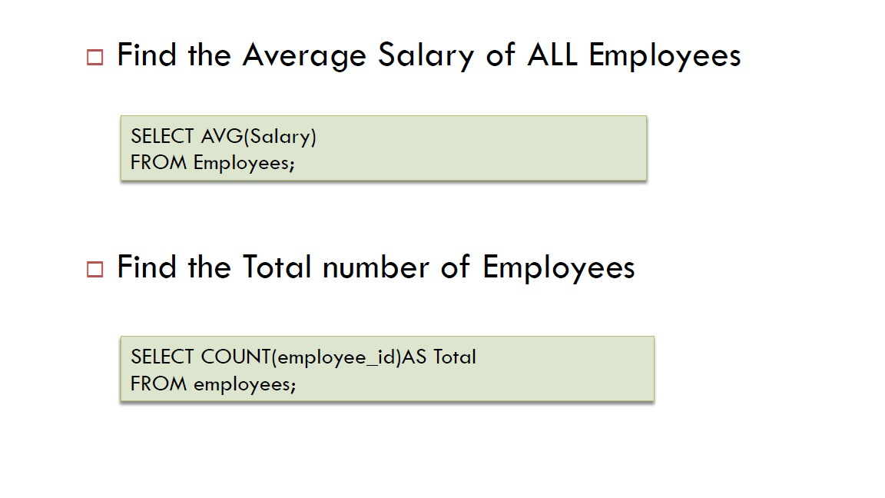
Examples

Slide 68
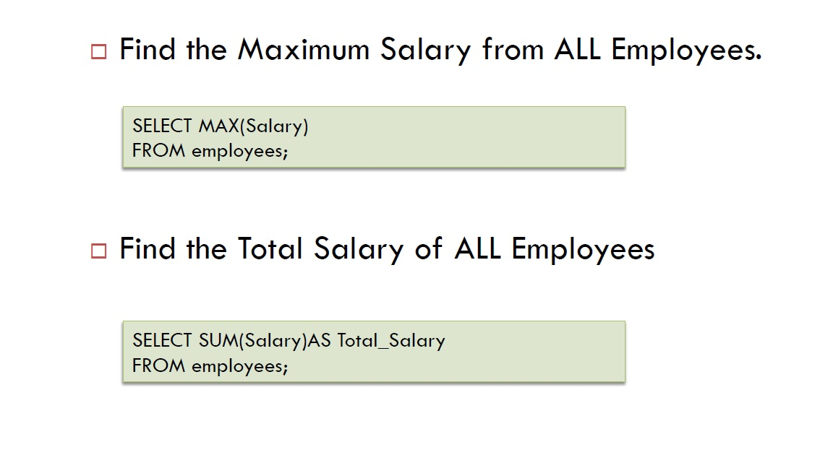
Examples

Slide 69
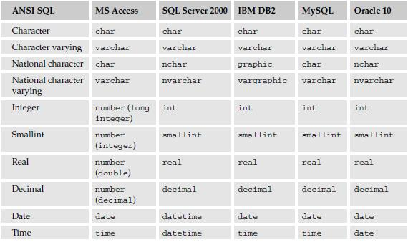

Slide 70
DATA TYPE | Description
char | Maximum length of 8,000 characters.( Fixed length non-Unicode characters)
varchar | Maximum of 8,000 characters.(Variable-length non-Unicode data).
varchar(max) | Maximum length of 231characters, Variable-length non-Unicode data (SQL Server 2005 only).
text | Variable-length non-Unicode data with a maximum length of 2,147,483,647 characters.

Slide 71
Date and Time Data Types
Note − Here, datetime has 3.33 milliseconds accuracy
where as smalldatetime has 1 minute accuracy.
DATA TYPE | FROM | TO
datetime | Jan 1, 1753 | Dec 31, 9999
smalldatetime | Jan 1, 1900 | Jun 6, 2079
date | Stores a date like June 30, 1991
time | Stores a time of day like 12:30 P.M.

Slide 72
Create Table
CREATE TABLE students (
student_id VARCHAR2(10) PRIMARY KEY,
last_name VARCHAR2(25) NOT NULL,
first_name VARCHAR2(25) NOT NULL,
Street VARCHAR2(25),
city VARCHAR2(25),
state CHAR(2),
zip_code CHAR(5),
expected_salary NUMBER(6) );

Slide 73
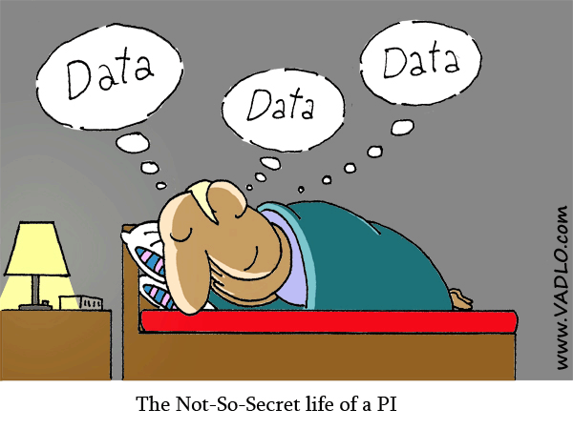
THANKS

Slide 74
JOIN

Slide 75
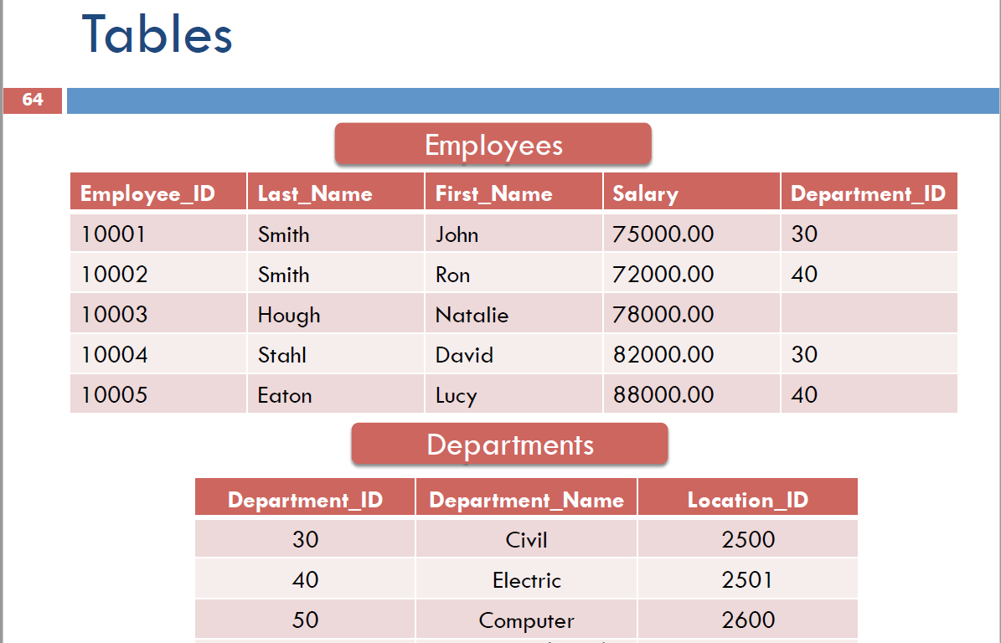

Slide 76
Table must be related data-Cant join if not related
How to know the two tables are related?-By common column.

Slide 78
Join type
Inner
OUTER
Full
Self
RIGHT OUTER
LEFT OUTER
Equijoin
Non-Equijoins
Cross-join/ Cartesian Product

Slide 79
INNER | RT OUTER | LF OUTER | FULL | SELF
Return matching data or row | Rt –ALL LT- Matching | LT-ALL RT-Matching | ALL matching and Unmatching | Join table it self

Slide 80
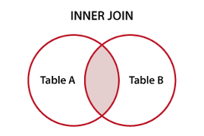
A
B

Slide 81
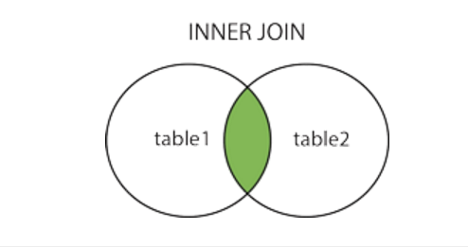
INNER JOIN
Only records that have matching values in both tables
SELECT column_name(s) FROM table1 INNER JOIN
table2
ON table1.column_name = table2.column_name;

Slide 82
Matching vs Un-matching
Matching by inner join
If not matching >>> will not retrieve data
How to retrieve missing/unmatching data??- need outer join
OUTER JOIN: retrieve matching and un-matching rows from two or multiple tables

Slide 83
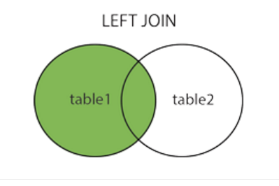
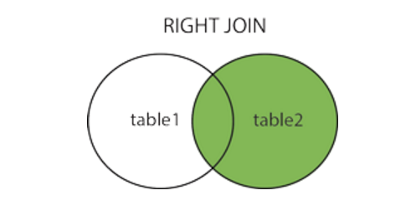
OUTER
Left OUTER
Rt OUTER
LEFT OUTER join | RIGHT OUTER join
All data from left | All data from Right
Only matching from Right | Only matching from Left

Slide 84
SELECT column_name(s) FROM table1 LEFT JOIN table2
ON table1.column_name = table2.column_name;
SELECT column_name(s) FROM table1 RIGHT JOIN table2
ON table1.column_name = table2.column_name;

Slide 85
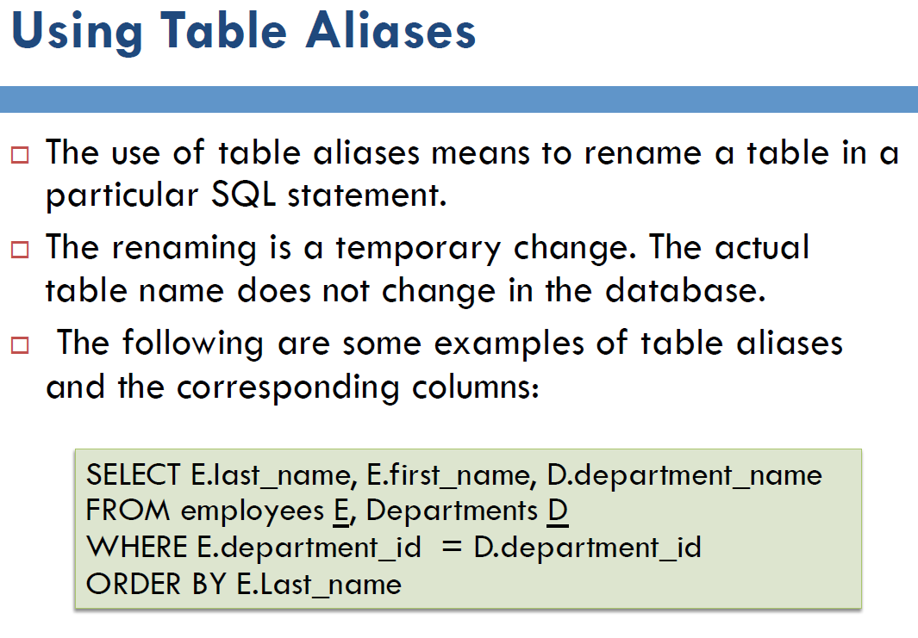

Slide 86
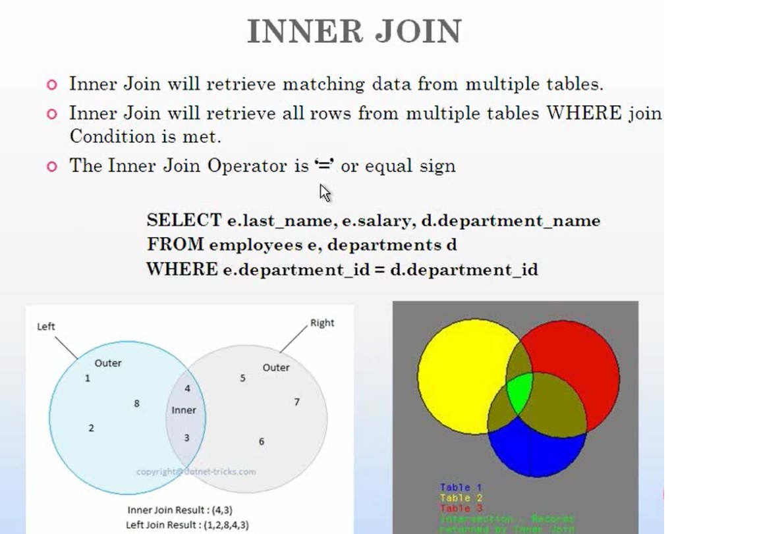

Slide 87
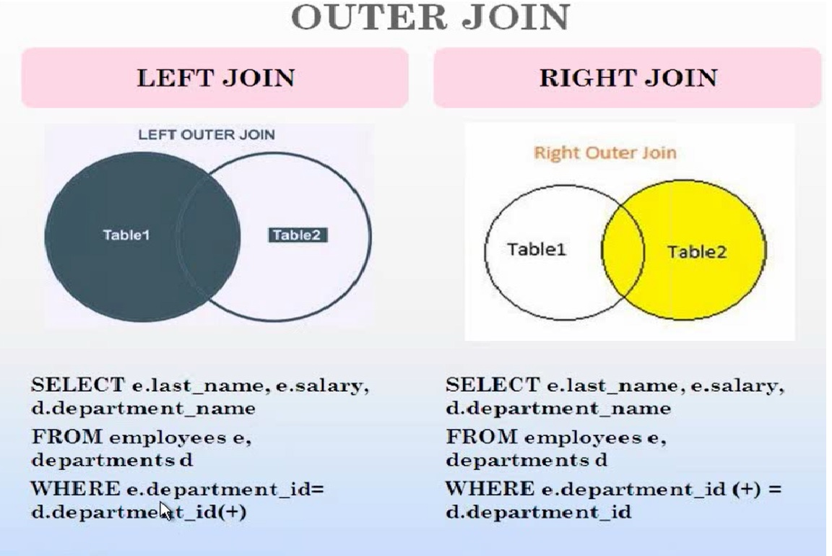

Slide 88
Join type
Equijoin
Non-Equijoins
Equi join | Non-Equi join
Join with = sign | Join with not equal sign- !=,<=,>=,<>
Return only matching row | Return non-matching row
Example: Inner join | Example: Outer join

Slide 89
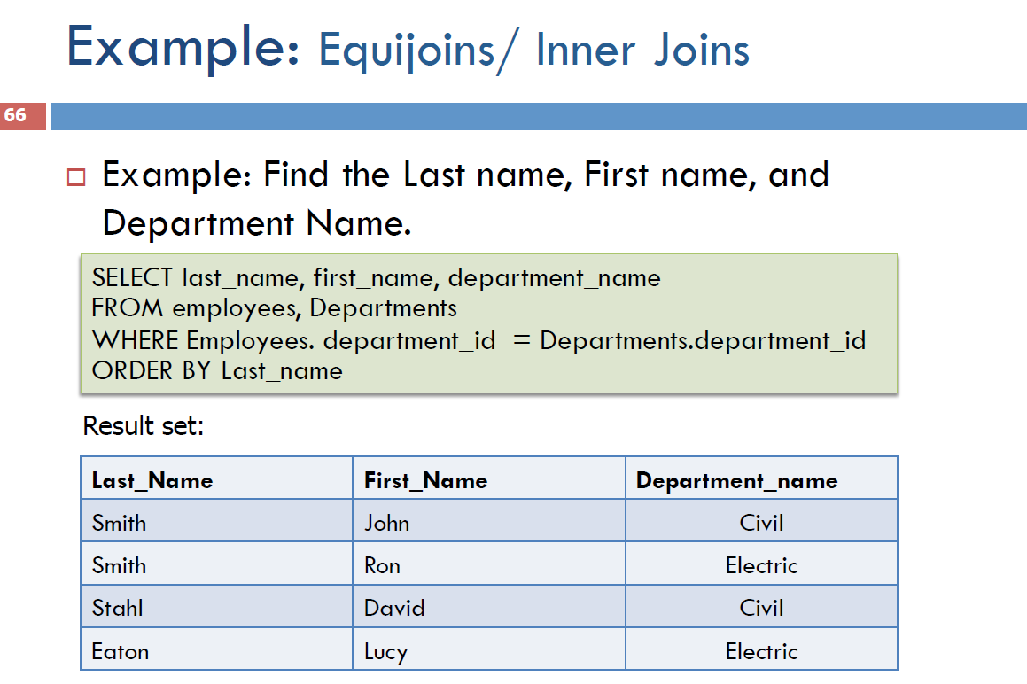

Slide 90
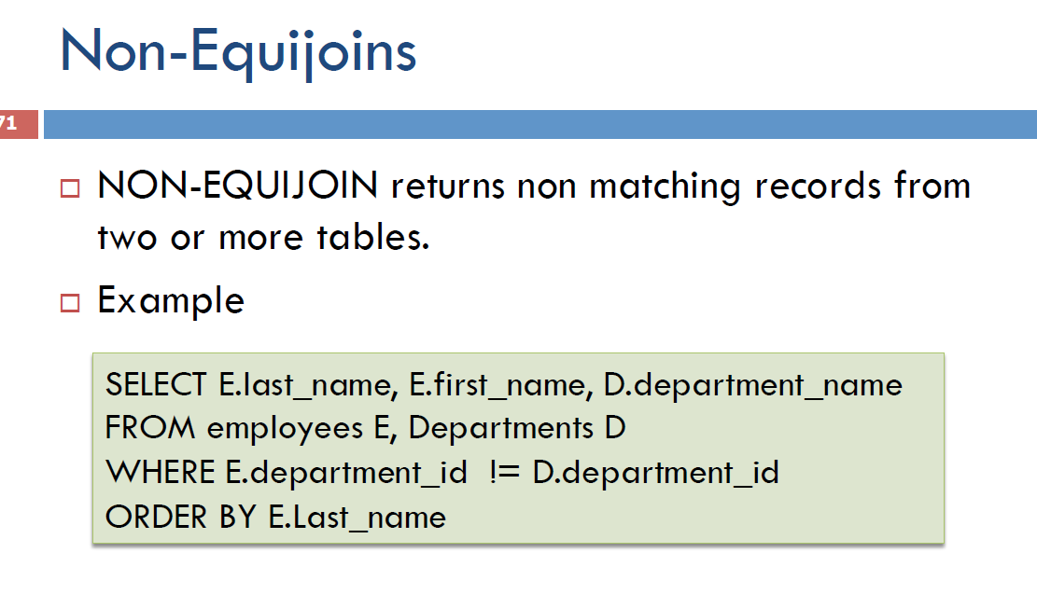

Slide 91
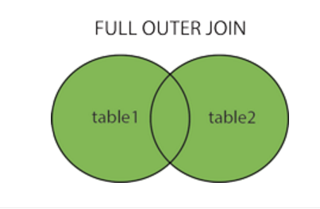
FULL OUTER JOIN
The FULL OUTER JOIN keyword return all records when there is a match in either left (table1) or right (table2) table records.
Note: FULL OUTER JOIN can potentially return very large result-sets!

Slide 92
Full join
SELECT column_name1, column_name2 FROM table1 FULL OUTER JOIN
table2
ON table1.column_nam1e,column_name2 =
table2.column_name1, column_name2;

Slide 93
Self JOIN
table is joined with itself
Only one table join here
SELECT column_name(s) FROM table1 T1, table1 T2 WHERE condition;

Slide 94
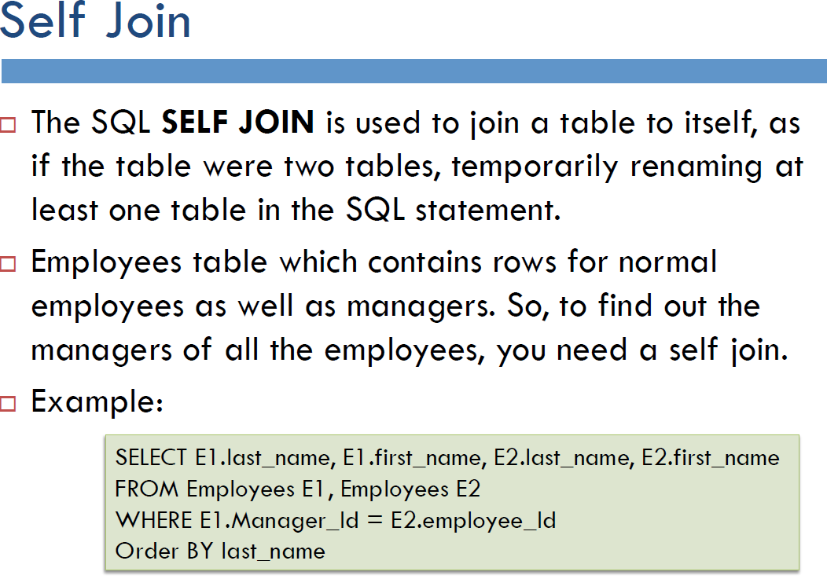

Slide 95
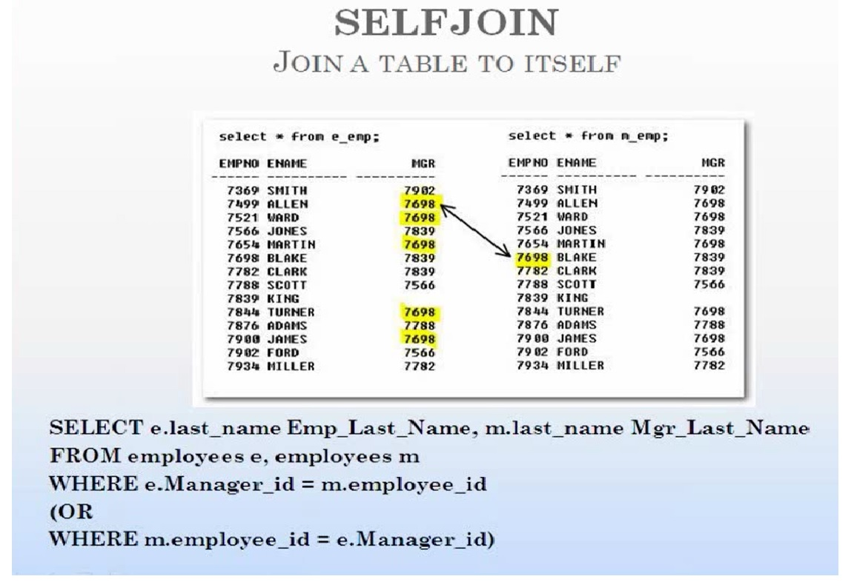

Slide 96
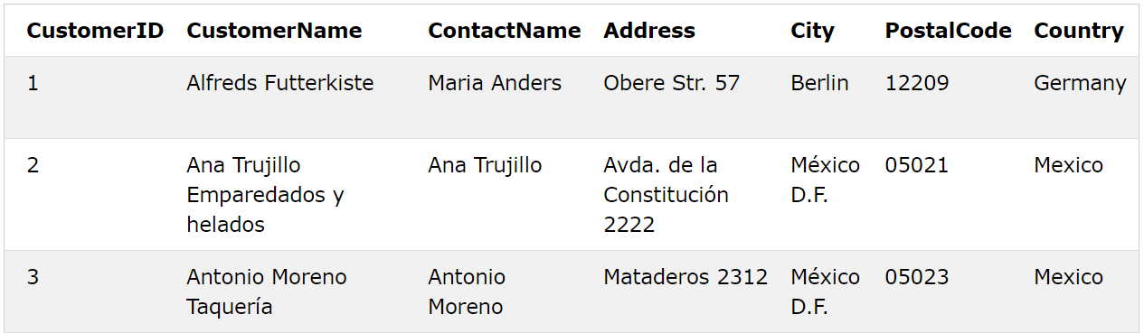

Slide 97
SELECT A.CustomerName AS CustomerName1, B.CustomerName AS CustomerName2, A.City FROM Customers A, Customers B WHERE A.CustomerID <> B.CustomerID AND A.City = B.City ORDER BY A.City;

Slide 98
SELECT E.Last_Name, E.First_Name, D.Department_Name, L.City
FROM Employees E Inner Join Departments D
On E.Department_Id = D.Department_Id
Inner Join Location L
On L.Location_Id = D.Location_Id
SELECT E.last_name, E.first_name, D.department_name
FROM employees E, Departments D
WHERE E.department_id = D.department_id
ORDER BY E.Last_name

Slide 99
SELECT E.last_name, E.first_name, D.department_name
FROM employees E
LEFT JOIN Departments D
ON E.department_id = D.department_id
SELECT E.last_name, E.first_name, D.department_name
FROM employees E
RIGHTJOIN Departments D
ON E.department_id = D.department_id
SELECT E.last_name, E.first_name, D.department_name
FROM employees E
FULL JOIN Departments D
ON E.department_id = D.department_id

Slide 100
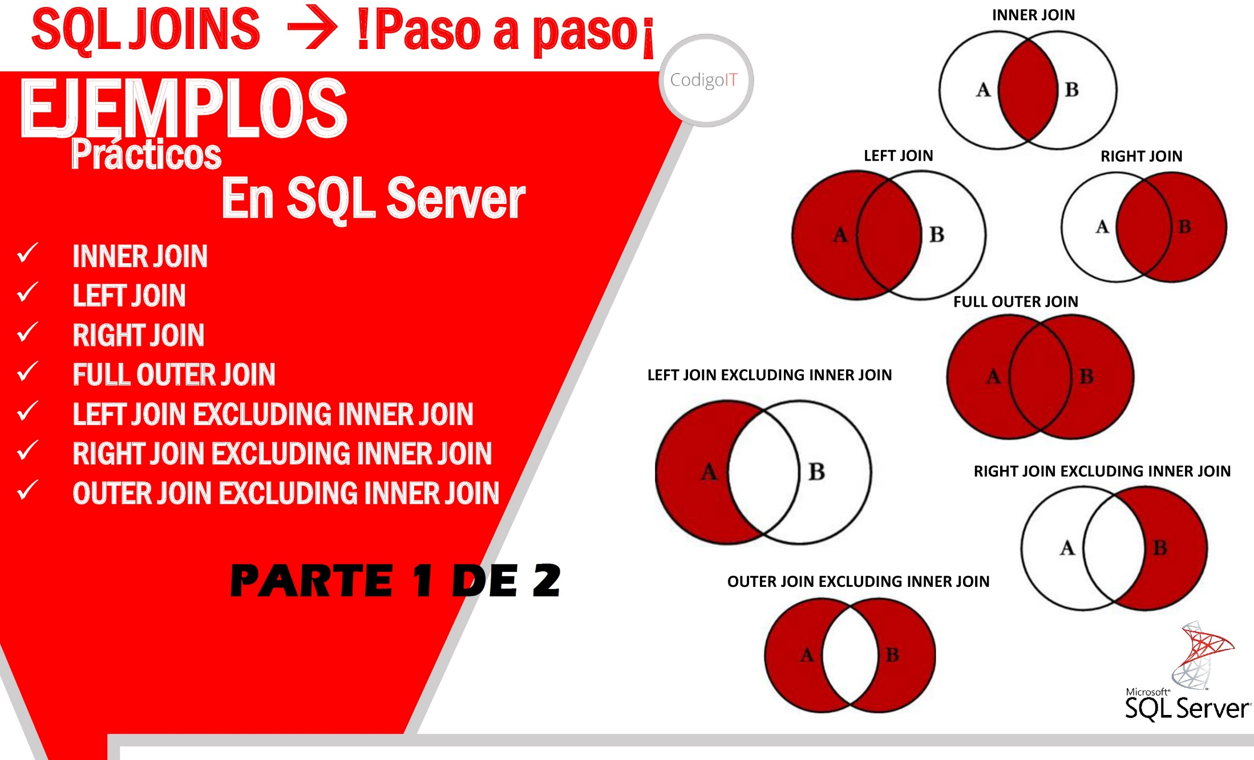

Slide 101


Slide 102
CROSS JOIN
number of rows in the first table multiplied by the number of rows in the second table if no WHERE clause is used along with CROSS JOIN. This kind of result is called as Cartesian Product.
If WHERE clause is used with CROSS JOIN, it functions like an INNER JOIN.
Syntax
SELECT * FROM table1
CROSS JOIN
table2;

Slide 103
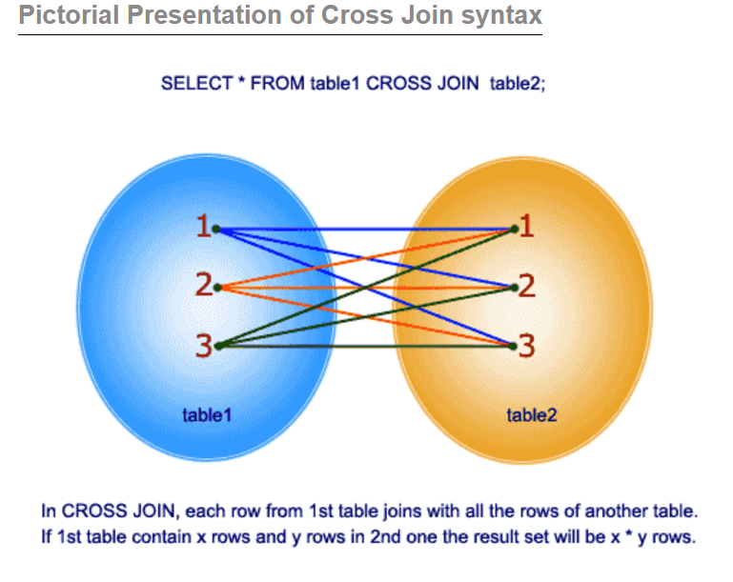

Slide 104
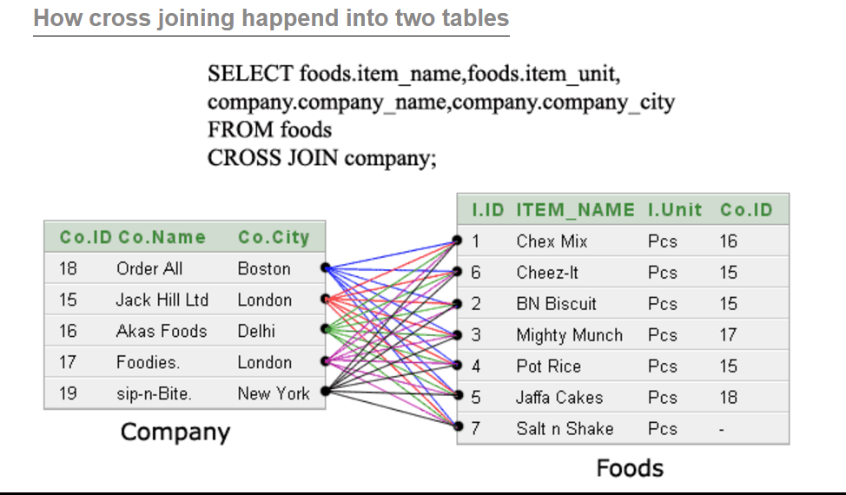
Out come of cross joint called: CARTESION PRODUCT

Slide 105
Join more than two table
Select First_Name,Last_Name,deptment_name,City
From employee inner joint
Department
On Employee.Department_id= Department.Department_id
Inner join Location
On Location.Location_id= Department.Location_id

Slide 106

THANKS

Slide 107
GROUP BY

Slide 108
Company Name | Product_Name
Apple | Mac book
Sony | TV
Apple | IPhone
Apple | TV
Apple | iPad
Samsung | TV
Samsung | Galaxy
Table 1: Company
Find out lowest price iPhone
Product_Nmae | Price
IPhone 6 | 600
IPhone 7 | 800
Iphone5 | 200
IPhone 4 | 100
Apple TV | 2000
Samsung TV | 3000
Sony TV | 2200
Table2: Price

Slide 109
Syntax:
Select product_Name, min(price)
From company
Inner join
Price
ON Company.product_Name=Price. product_Name
Group by product_name
Where product_name = Iphone
Having min(price)

Slide 110
Find department name name with more than 5 employee
Select department_name, count(employee_id)
From employees inner join departments
ON employees.department_id=depatments.department_id
GROUP By department_name
Having count(employee_id)> 5

Slide 111
Group by rules
What ever select in group by that statement must be in select statement.
SELECT Department_id, AVG(Salary)
FROM Employees
GROUP BY Department_id;
Filter row with having using aggregate function
SELECT Department_id, AVG(Salary)
FROM Employees
GROUP BY Department_id;
Having COUNT(employee_id)>5;

Slide 112
GROUP BY & HAVING
GROUP BY –Group Identical Data; used primarily with aggregate functions(return the total value of the column)
Find the Average Salary of each Department.
SELECT Department_id, AVG(Salary)/sum(salary)/
FROM Employees
GROUP BY Department_id; or
SELECT Department_id,ROUND (AVG(Salary)/sum(salary)) as salary
FROM Employees
GROUP BY Department_id;

Slide 113
HAVING – Filters rows from created groups.(FILTER GROUP DATA)
Find the departments that has more than 5 employees.
SELECT Department_id, COUNT(employee_id)
FROM Employees
GROUP BY Department_id
Having COUNT(employee_id)>5;

Slide 114
Different between where & having
Where filter any data row
Having filter only group data row

Slide 115
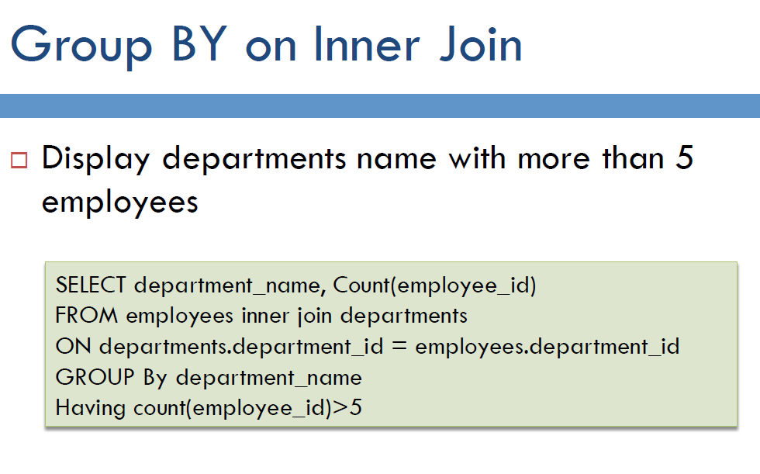

Slide 116
Group BY on Outer Join
SELECT department_name, Count(employee_id)
FROM employees
Left join departments
ON departments.department_id = employees.department_id
GROUP By department_name
Having count(employee_id)>5

Slide 117
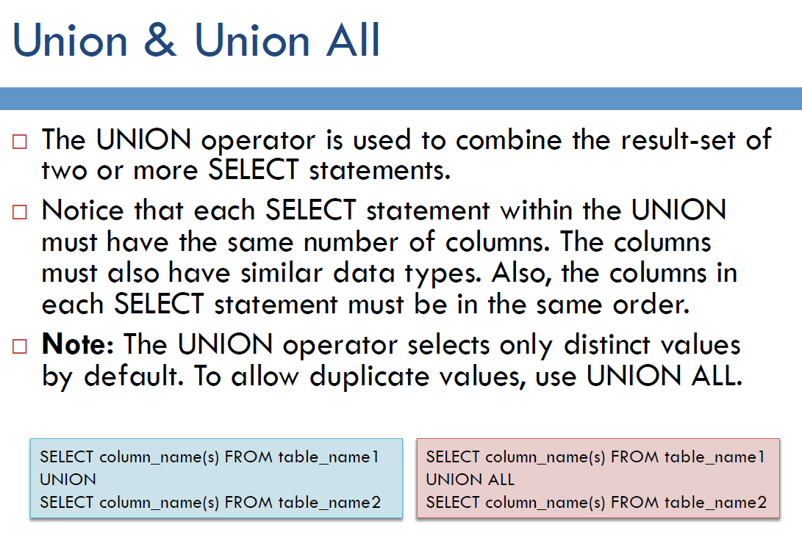

Slide 118
Union Rules
When need combine the result of two or more SELECT statements /Table.
Each SELECT statement within UNION must have the same number of columns
The columns must also have similar data types
The columns in each SELECT statement must also be in the same order
No duplicate vale
If need duplicate vale use –Union ALL

Slide 119
Union
SELECT column_name1, column_name2 FROM table1 UNION SELECT column_name1, column_name2
FROM table2;
UNION ALL
SELECT column_name1, column_name2 FROM table1 UNION ALL SELECT column_name1, column_name2
FROM table2;

Slide 120
UNION With WHERE
SELECT city, phone_number FROM student WHERE city=‘New York' UNION SELECT city, phone_number FROM student WHERE city=‘New York' ORDER BY city;

Slide 121
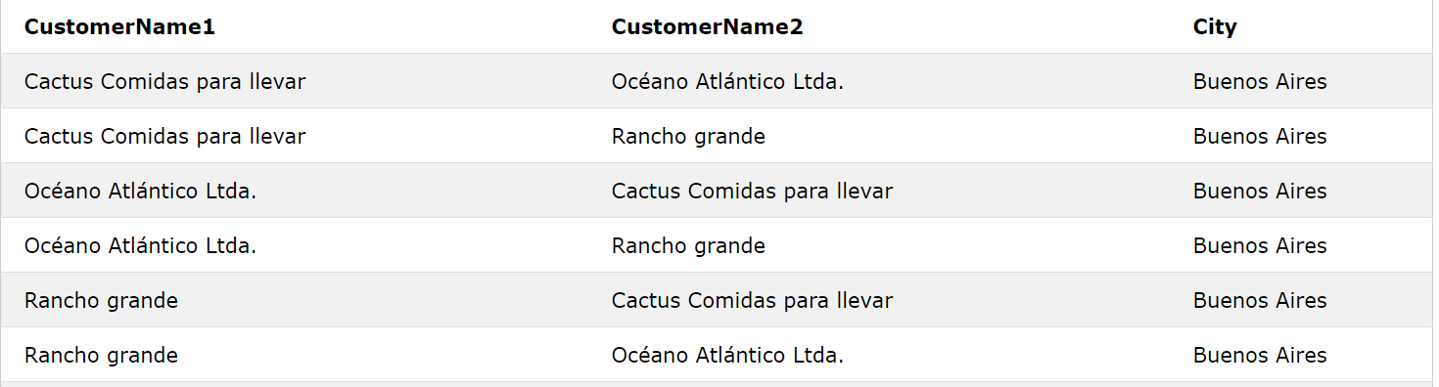

Slide 122
SELECT E.Last_Name, E.First_Name, D.Department_Name, L.City
FROM Employees E Inner Join Departments D
On E.Department_Id = D.Department_Id
Inner Join Location L
On L.Location_Id = D.Location_Id
SELECT E.last_name, E.first_name, D.department_name
FROM employees E, Departments D
WHERE E.department_id = D.department_id
ORDER BY E.Last_name

Slide 123
SELECT E.last_name, E.first_name, D.department_name
FROM employees E
LEFT JOIN Departments D
ON E.department_id = D.department_id
SELECT E.last_name, E.first_name, D.department_name
FROM employees E
RIGHTJOIN Departments D
ON E.department_id = D.department_id
SELECT E.last_name, E.first_name, D.department_name
FROM employees E
FULL JOIN Departments D
ON E.department_id = D.department_id

Slide 124
More requirement or problems

Slide 125
The TOP keyword restricts the number of results returned from a SQL statement in Microsoft SQL Server/MySQL.
Top used to find top rows
Syntax
The syntax for TOP is as follows:
SELECT TOP [TOP argument] "column_name" FROM "table_name";

Slide 126
ROWNUM: SQL server/Oracle
ROWNUM used to find top rows
Syntax
The syntax for ROWNUM is as follows:
SELECT "column_name" FROM "table_name";
Where ROWNUM=1
Or
Where ROWNUM<=10

Slide 127
Find salary & name for all employees in desc
Select first_name,last_name,salary
From employees
Orderby salary desc

Slide 128
Max or min Salary
Aggregate function
Syntax:
Select max(salary)
From employee
Select min(salary)
From employee

Slide 129
Max salary
select max(salary)
from employees
Select first_name,last_name,salary
From employees
Where salary = (select max(salary)from employees)
Select first,last_name, salary
From employees
Where rownum = 1

Slide 130
2nd max salary
select max(salary) from employees
Where salary < (select max(salary) from employees
Where salary < (select max(salary) from employees))

Slide 131
2nd /5th/9th max/min salary
For subsequent order or rank salary –use RANK or DENS_RANK function
Syntax:
select(select name, salary, DANSE_RANK()over(PARTISION BY deptno ORDER BY salary) rank/as rank/ranking
From employee
Where rank/ranking= 9

Slide 132
2nd highest
Select first_name,last_name,salary
From employees
Where salary <> (select max(salary)from employees)
Or
where rownum <= 2
Or
Select distinct (A.salary)
From employee A
Where 2= (select count(distinct B.salary))
From employees B
Where A.salry <= B.salary

Slide 133
GROUP BY

Slide 134
GROUP BY & HAVING
GROUP BY –Group Identical Data; used primarily with aggregate functions(return the total value of the column)
Find the Average Salary of each Department.
SELECT Department_id, AVG(Salary)/sum(salary)/
FROM Employees
GROUP BY Department_id; or
SELECT Department_id,ROUND (AVG(Salary)/sum(salary)) as salary
FROM Employees
GROUP BY Department_id;
HAVING – Filters rows from created groups.(FILTER GROUP DATA)
Find the departments that has more than 5 employees.
SELECT Department_id, COUNT(employee_id)
FROM Employees
GROUP BY Department_id
Having COUNT(employee_id)>5;

Slide 135
Different between where & having
Where filter individual data row
Having filter group data row

Slide 136
Group by rules
What ever select in group by that statement must be in select statement.
SELECT Department_id, AVG(Salary)
FROM Employees
GROUP BY Department_id;

Slide 137
Union
Purpose of the SQL UNION query is to combine the results of two queries together while removing duplicates. In other words, when using UNION, only unique values are returned (similar to SELECT DISTINCT).

Slide 138
Syntax
The syntax of UNION in SQL is as follows:
[SQL Statement 1] UNION [SQL Statement 2];
The columns selected in [SQL Statement 1] and [SQL Statement 2] need to be of the same data type for UNION to work.

Slide 139
Table Store_Information
Store_Name | Sales | Txn_Date
Los Angeles | 1500 | Jan-05-1999
San Diego | 250 | Jan-07-1999
Los Angeles | 300 | Jan-08-1999
Boston | 700 | Jan-08-1999
Table Internet_Sales
Txn_Date | Sales
Jan-07-1999 | 250
Jan-10-1999 | 535
Jan-11-1999 | 320
Jan-12-1999 | 750
Txn_Date
Jan-05-1999
Jan-07-1999
Jan-08-1999
Jan-10-1999
Jan-11-1999
Jan-12-1999
SELECT Txn_Date FROM Store_Information UNION SELECT Txn_Date FROM Internet_Sales;
RESULT

Slide 140
Union All
The purpose of the SQL UNION ALL command is to combine the results of two queries together without removing any duplicates.

Slide 141
Table Store_Information
Store_Name | Sales | Txn_Date
Los Angeles | 1500 | Jan-05-1999
San Diego | 250 | Jan-07-1999
Los Angeles | 300 | Jan-08-1999
Boston | 700 | Jan-08-1999
Table Internet_Sales
Txn_Date | Sales
Jan-07-1999 | 250
Jan-10-1999 | 535
Jan-11-1999 | 320
Jan-12-1999 | 750
Txn_Date
Jan-05-1999
Jan-07-1999
Jan-08-1999
Jan-08-1999
Jan-07-1999
Jan-10-1999
Jan-11-1999
Jan-12-1999
SELECT Txn_Date FROM Store_Information UNION ALL SELECT Txn_Date FROM Internet_Sales
RESULT

Slide 142
UNION vs UNION ALL
UNION and UNION ALL both combine the results of two SQL queries. The difference is that,
while UNION only returns distinct values, UNION ALL selects all values.

Slide 143
Index Statement
As mentioned in the Index overview page, a table index helps SQL statements run faster. The syntax for creating an index is:
CREATE INDEX "index_name" ON "table_name" (column_name);
Note that an index can only cover one table. We cannot build an index that covers multiple tables

Slide 144
Table Customer
Column Name | Data Type
First_Name | char(50)
Last_Name | char(50)
Address | char(50)
City | char(50)
Country | char(25)
Birth_Date | datetime
we want to create an index on the column Last_Name, we would type in,
CREATE INDEX IDX_CUSTOMER_LAST_NAME ON Customer (Last_Name);
If we want to create an index on both City and Country, we would type in,
CREATE INDEX IDX_CUSTOMER_LOCATION ON Customer (City, Country);

